Slide 1
Digit Recognition Model
Sonia
ITC

Slide 2
Use Case
HDFC is looking to double its SME Loans portfolio by the end of 2027.
Current IT Landscape for SME Loans
Front end: Website with API Endpoints for booking the loan applications in AWS landscape.
RDS Database is storing the data of final loan applications and their subsequent processing.
Team of 1 manager and 7 employees responsible for entering the paper based applications into system which takes roughly 150 manhours per month.

Slide 3
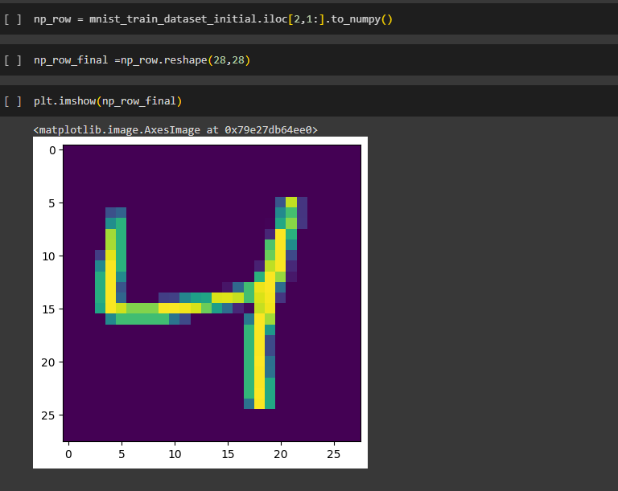
Dataset
Dataset Description
The data files train.csv and test.csv contain gray-scale images of hand-drawn digits, from zero through nine.
Each image is 28 pixels in height and 28 pixels in width, for a total of 784 pixels in total. Each pixel has a single pixel-value associated with it, indicating the lightness or darkness of that pixel, with higher numbers meaning darker. This pixel-value is an integer between 0 and 255, inclusive.
The training data set, (train.csv):
60,000 rows
787 columns: unnamed and index column dropped to make it 785. 1 column for digit label and 784 for image information
1 row with Null values dropped
Final Dataset has X_train and y_train as image data and label respectively.

Slide 4
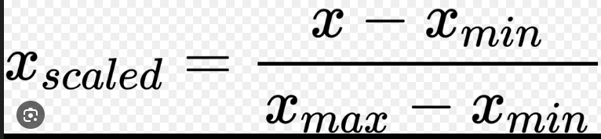
Data Cleaning and EDA
Irrelevant columns dropped : unnamed and extra index column
Dropped row with Null values
Scaling the data via Min Max Scaler
X_train_independent_var_scaled_dataset =
(X_train_independent_var_dataset -(X_train_independent_var_dataset.min()))/(X_train_independent_var_dataset.max()-X_train_independent_var_dataset.min())

Slide 5
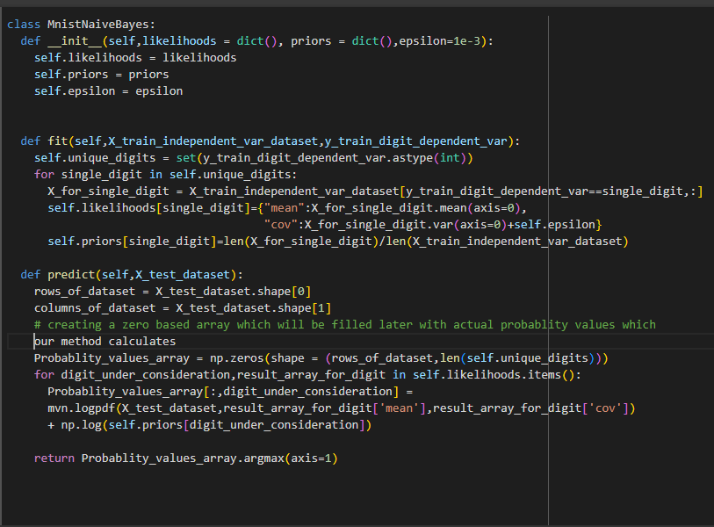

Naive Bayes algorithm
Assumption: Features are conditionally independent
Naive Bayes learners and classifiers can be extremely fast compared to more sophisticated methods.
The decoupling of the class conditional feature distributions means that each distribution can be independently estimated as a one dimensional distribution.
This in turn helps to alleviate problems stemming from the curse of dimensionality.
Results:
In case of Naive Bayes we got maximum accuracy of 82.12 with epsilon value 0.0121

Slide 6
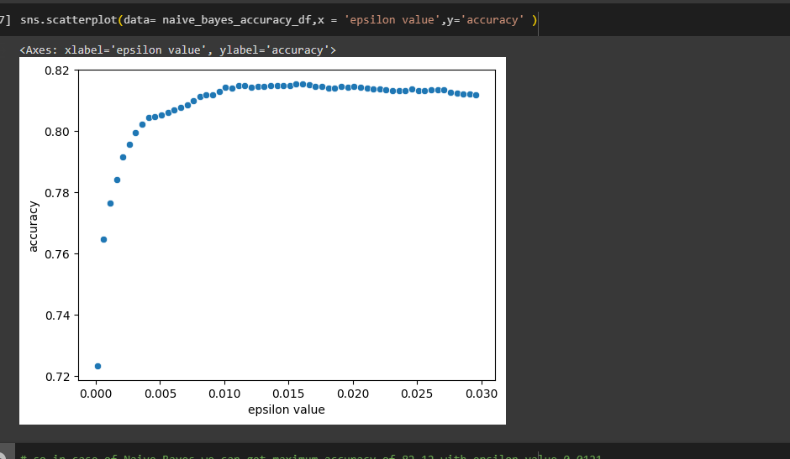
Hyperparameter tuning
in case of Naive Bayes we can get maximum accuracy of 82.12 with epsilon value 0.0121

Slide 7
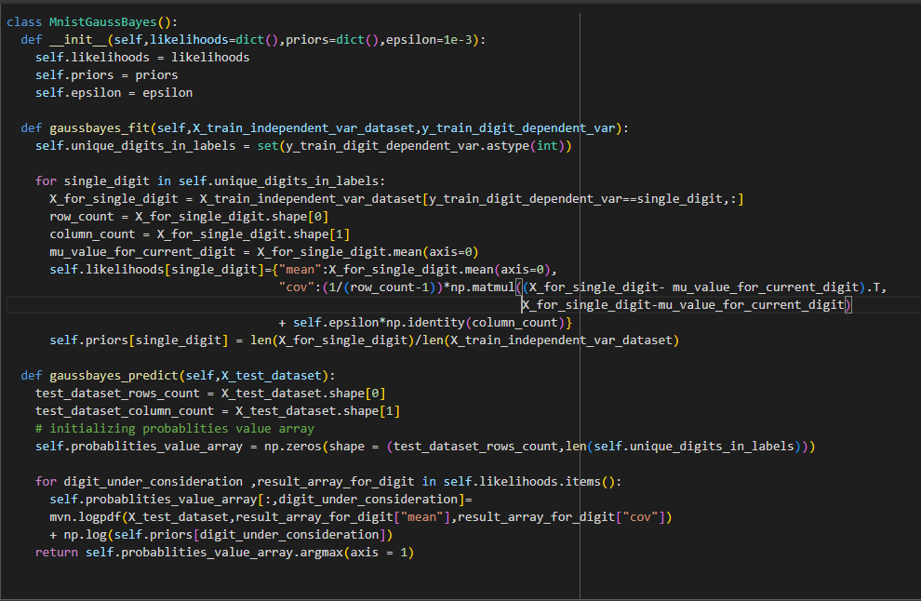
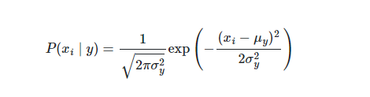
Gauss Bayes
What Is Gaussian Distribution?
Gaussian distribution is also called normal distribution.
Normal distribution is a statistical model that describes the distributions of continuous random variables in nature and is defined by its bell-shaped curve.
The two most important features of the normal distribution are the mean (μ) and standard deviation (σ).
The mean is the average value of a distribution, and the standard deviation is the “width” of the distribution around the mean

Slide 8
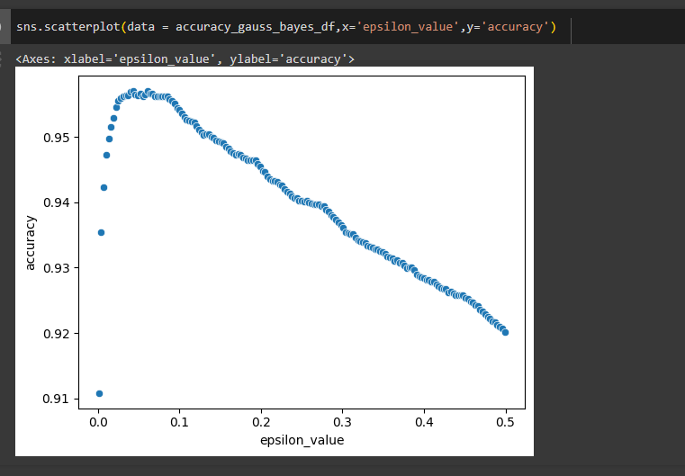
Hyperparameter tuning
After trying the below combinations we deduce that best accuracy = 95.69 with epsilon value : 0.065

Slide 9
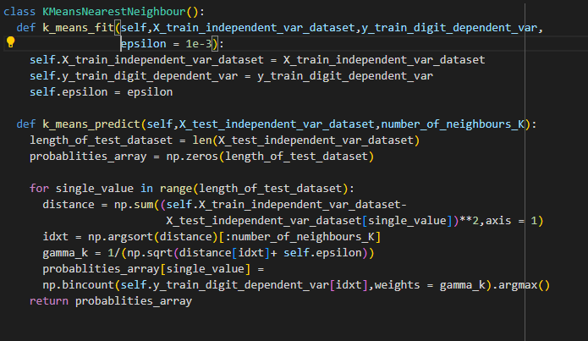
K Nearest Neighbour
Step #1 - Assign a value to K.
Step #2 - Calculate the distance between the new data entry and all other existing data entries (you'll learn how to do this shortly). Arrange them in ascending order.
Step #3 - Find the K nearest neighbors to the new entry based on the calculated distances.
Step #4 - Assign the new data

Slide 10
Hyperparameter tuning
We introduced different values of K to check the variation in accuracy.
Maximum accuracy for K = 15, 96.47%.
Time taken for each iteration ~ 40 min
K value | Accuracy
15 | 96.47
20 | 96.33
25 | 96.12
30 | 96.04
70 | 95.02
120 | 94.13
500 | 90.64
550 | 90.36

Slide 11
Conclusion and further steps:-
We finalize Gauss Bayes model based on its execution speed and accuracy.
We read the Loan applications with 95.69 % accuracy then the estimation saving of man hours from 150 hours to 5-6 hours per month. Job of person instead of team of current team size of 8.
Other employees time can be freed to do core banking activities rather than data entry.
Further steps:
Break even analysis and cost benefit analysis.

Slide 12
Thank you

